Slide 1
Research ideas and planning
09/21/2023
Yu Li

Slide 2
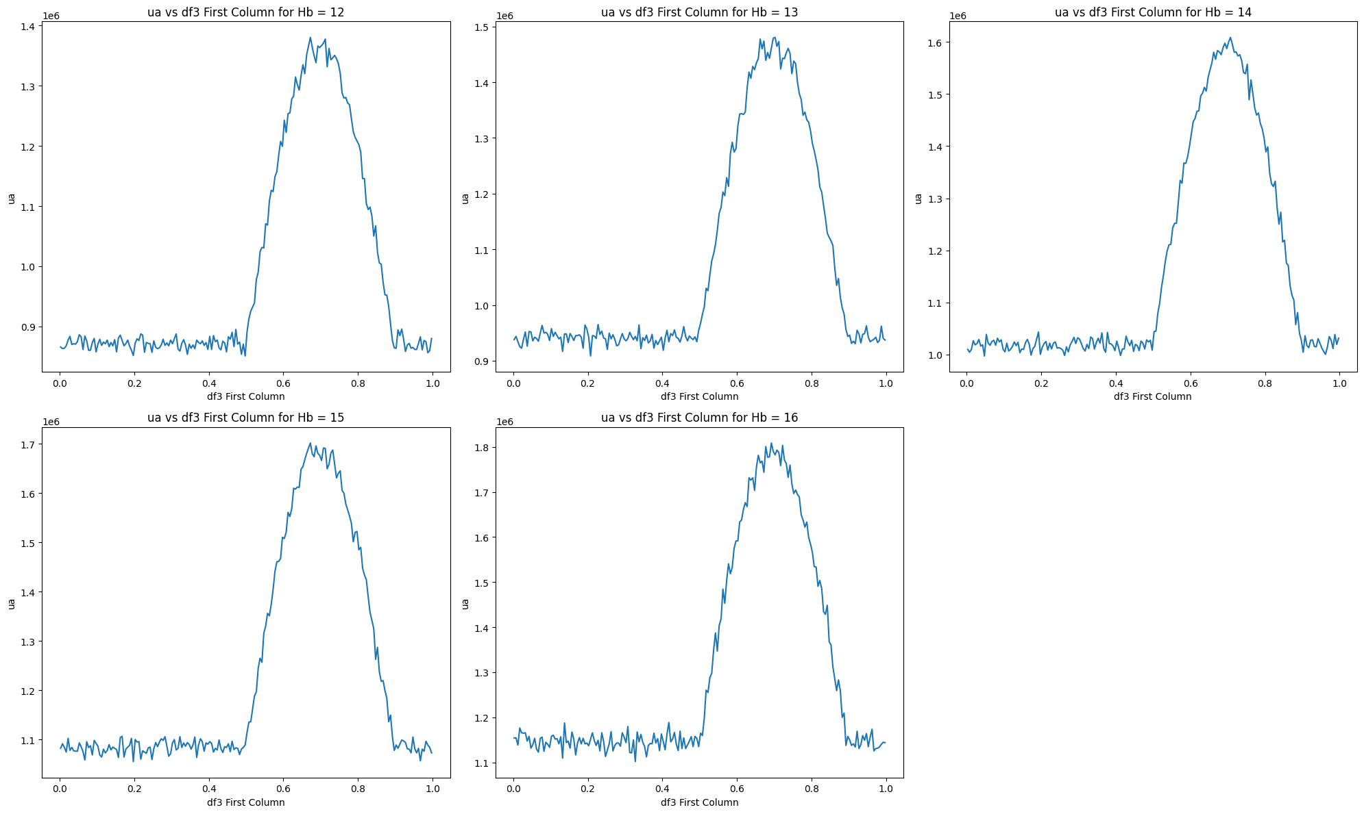
The change curve of μa in one cycle
In the last discussion and documentation, our process was about fixing the value of Spo2 and studying the relationship between ua and β.
By selecting the concentration range of Hb, we can give the change curve of μa in different individuals within a cycle.
Improvement: The blood vessel shape of each individual is differentiated.

Slide 3
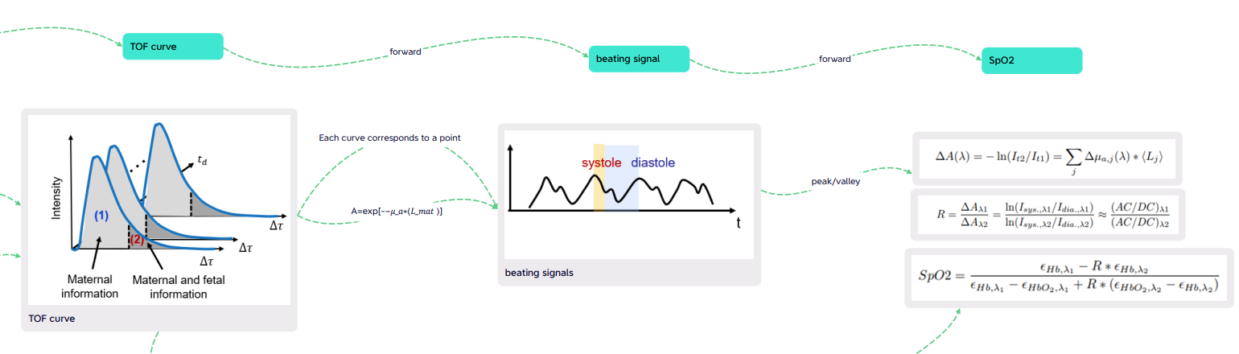
Research ideas about Spo2
Regarding how to obtain Spo2, there are still two ideas: forward and inverse.
Forward model process: It is shown in our forward model. What we need is TOF image data (the boundaries of each layer need to be divided) to calculate the beating singal curve. Then Spo2 is calculated through the formula.

Slide 4
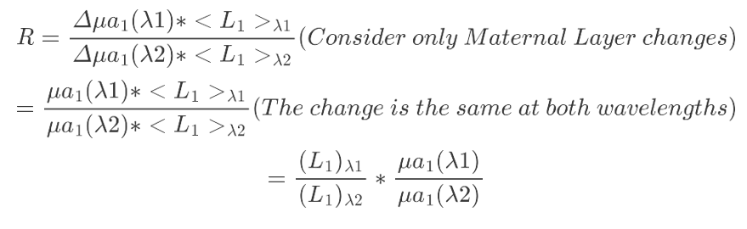

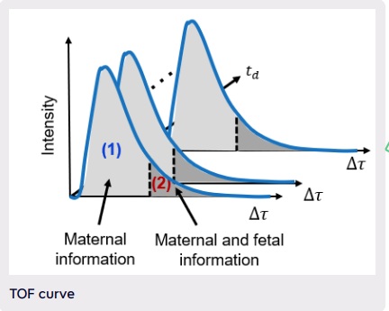
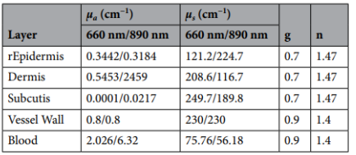
Research ideas about Spo2
Inverse model process:
This inverse model also relies on the data of the TOF image. We can establish the relationship between TOF and the set μa parameters of each layer, so that Spo2 can also be calculated.
The initial idea is to build an end-to-end neural network to directly predict the corresponding parameters through TOF image information.

Slide 5
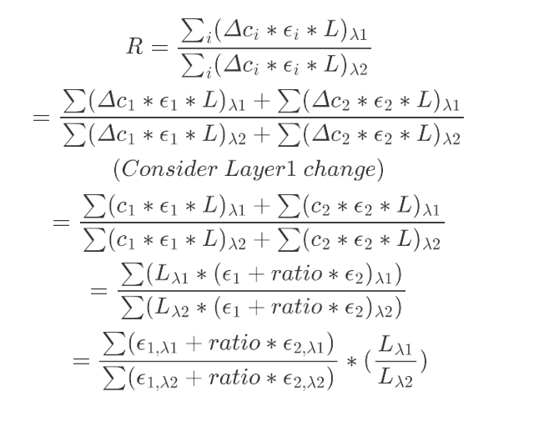
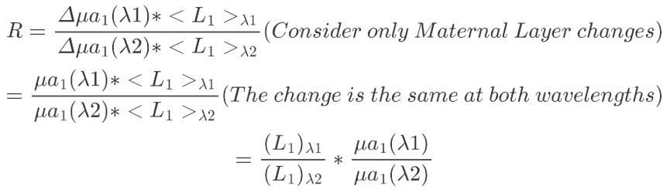
Expansion to include infants
Inspired by the single-objective model, I plan to start with the formula to find the factors that affect spo2 in the dual-objective model.
The main difference is that during the expansion of R, both expansions are affected. Especially the second way of expansion.

Slide 6
Future work
In the next two weeks, I can initially complete the analysis of the formula including babies.
After obtaining the TOF image data (not sure whether the image needs to be adjusted for the model, especially regarding the boundary demarcation of each layer), you can try to complete the complete process of the forward model and the general framework of the reverse model.

